Slide 1

Marketing Campaign Analysis Customer Response Prediction
Presented By: Mahadevan Ramanan Patrick Gervadis Ninan Shweta Rajeev Vineeth Varma Gokaraju

Slide 2

business problem
Our goal is to analyse and understand customer characteristics that will help us in predicting their response to a marketing campaign conducted by a Food Company.
By performing this analysis, we aim to enhance profitability in future marketing endeavours.
The outcome of interest (Y variable) is the "Response" variable, indicating whether a customer responded positively or negatively to a marketing campaign.
This analysis caters to Marketing Department Managers and Executives.

Slide 3
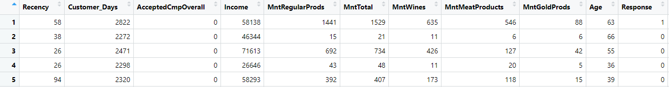
The dataset
It has the socio-economic and firmographic features of about 2200 customers who were contacted through a marketing campaign. Encompasses 39 variables and 2205 rows, including duplicate entries.
It is an imbalanced dataset where the response variable is not equally distributed.
From this extensive dataset, we have identified and focused on the 10 most significant features. Our analysis and response model are centred around these key features.

Slide 4
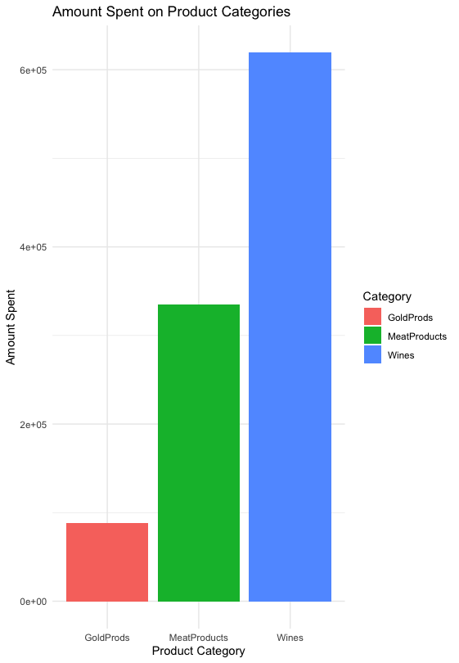
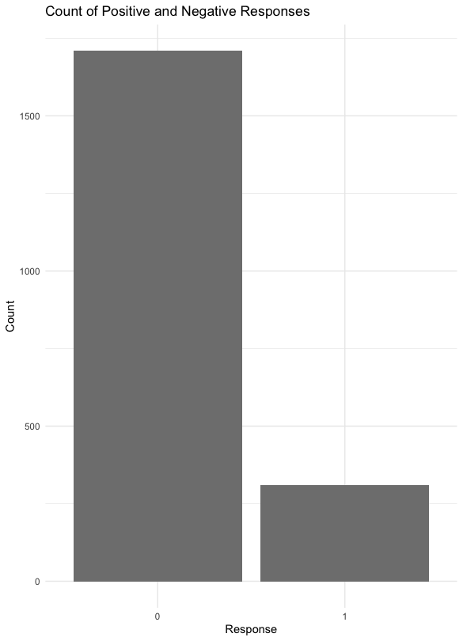
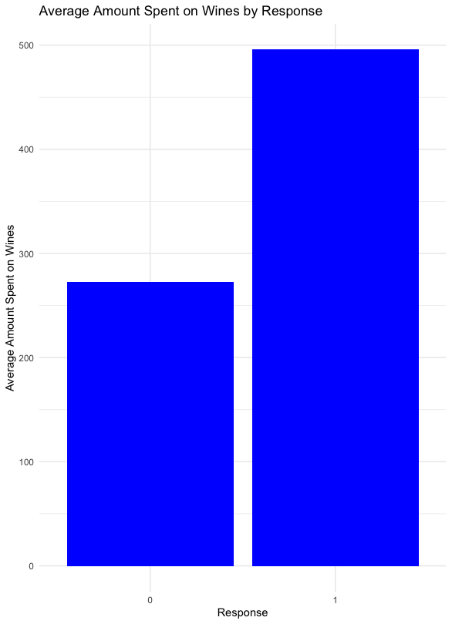
Data exploration

Slide 5
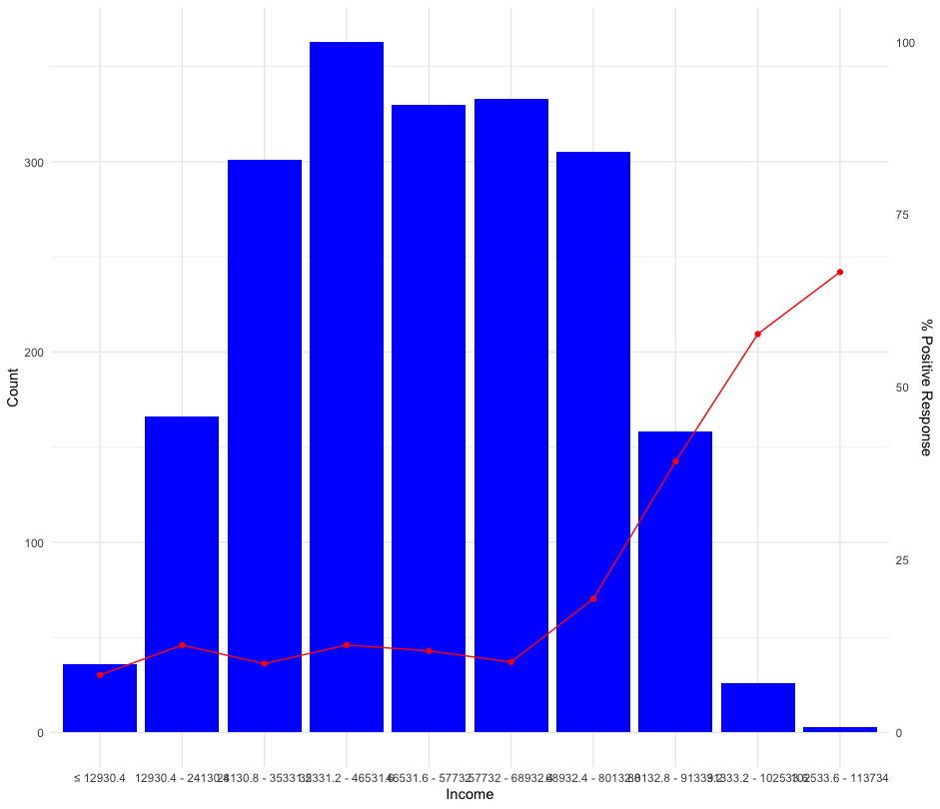
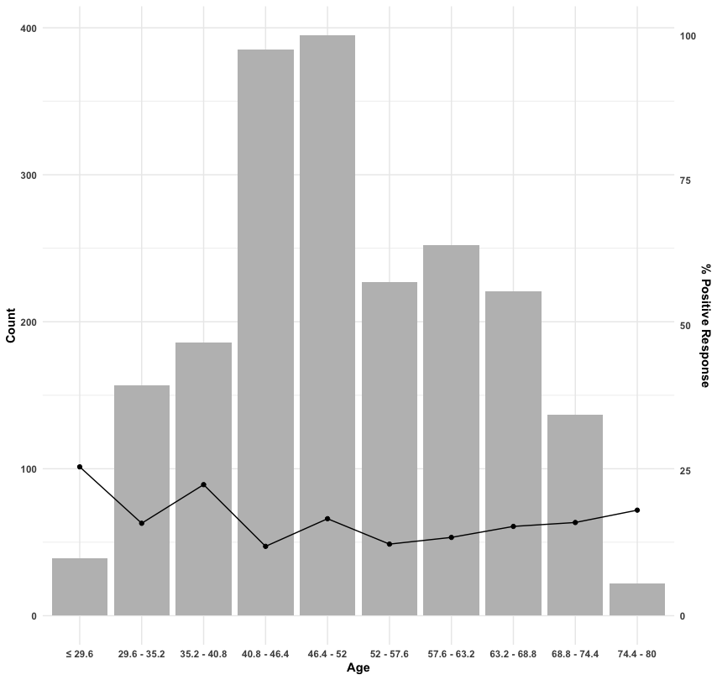
Data exploration

Slide 6

Response modeling
ML Algorithm | Accuracy | Sensitivity | Specificity
Logistic Regression | 0.773 | 0.776 | 0.757
Decision Tree | 0.737 | 0.739 | 0.729
Random Forest | 0.844 | 0.876 | 0.671

Slide 7

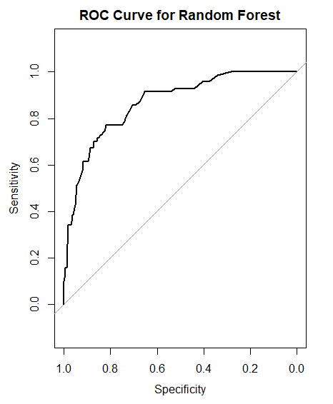
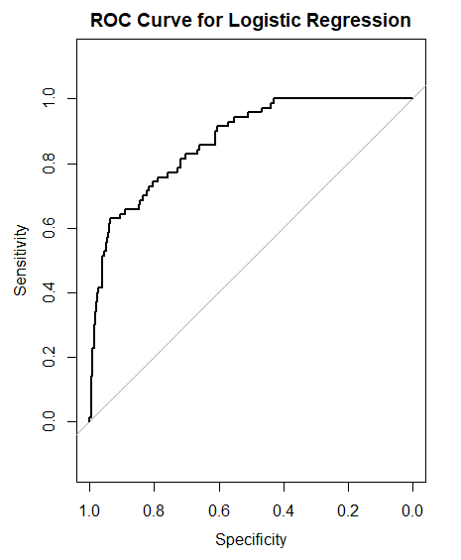
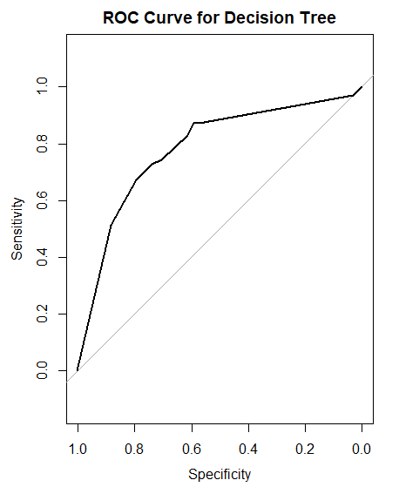
Response modeling
AUC Score: 0.867
AUC Score: 0.869
AUC Score: 0.785

Slide 8
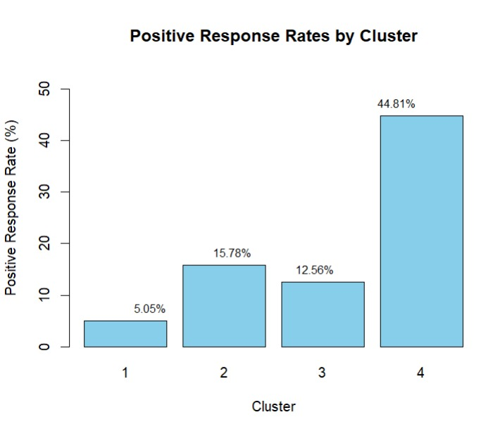

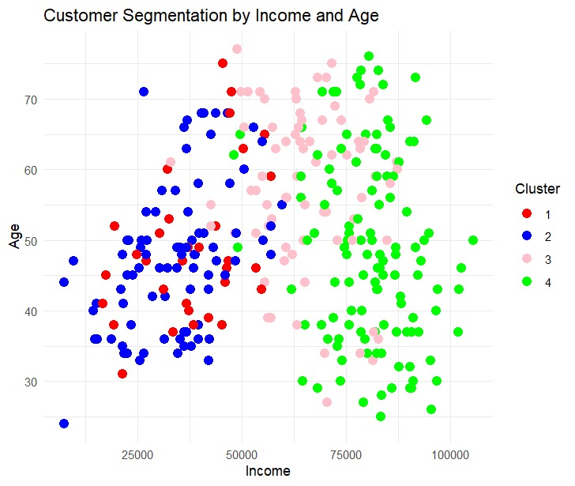
Identifying our Target Group
High Income: The cluster with the best response rate
exhibits the highest average income of approximately $78,800.03, suggesting stronger purchasing potential and propensity to engage with marketing campaigns.

Slide 9
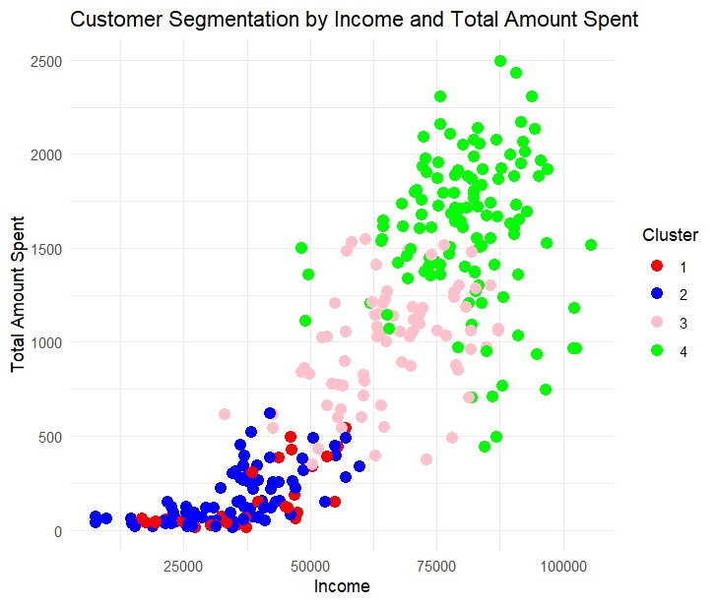
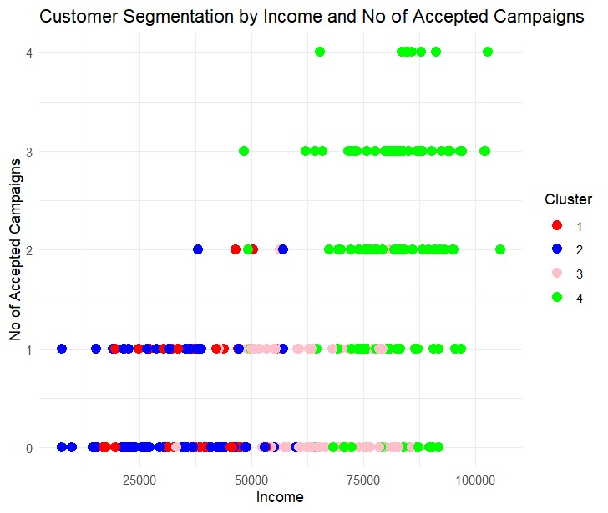
Identifying our Target Group
High Spending on Products: The cluster with the best response rate exhibits the highest average expenditure across multiple product categories, implying their proactive consumer behaviour and propensity to engage with pertinent marketing offers.
Acceptance of Overall Campaigns: The cluster with the best response rate demonstrates a notably high average acceptance rate for overall campaigns, reflecting their receptivity to diverse marketing initiatives and potential positive response to novel campaign strategies or promotions.

Slide 10

Conclusion
Performing predictive modelling allows us to forecast customer responsiveness to our marketing campaigns accurately.
The Random Forest model seems to perform the best overall, as it has the highest accuracy, sensitivity, and AUC, indicating its effectiveness in predicting customer response based on various attributes.
We also observed that Customers with higher income levels, strong purchasing power, high engagement with the brand, and a positive attitude towards marketing campaigns exhibit a positive response towards campaigns.
Targeting customers with these characteristics with tailored marketing strategies and offers is likely to yield the best results in terms of response rates and profitability.
Understanding customer behaviour and characteristics empowers the marketing team to craft more effective campaigns. By identifying customers more likely to respond positively, resources can be allocated efficiently, ultimately maximizing profitability.

Slide 11

Thank you!

